Slide 1
TRAUMA AND SEXUAL VIOLENCE common dynamics in COLLEGE STUDENTS
Willa Campbell, BS, Victim Advocate
Susie Balcom, MSW, Victim Advocate
Notes:
Welcome and PAAR intro.

Slide 2
Our Mission
To respond, educate, and advocate to end sexual violence.
Notes:
Who we are- 2nd oldest, dawn of the thirdwave of the feminism movement in the 70s.
Providing content warning.

Slide 3
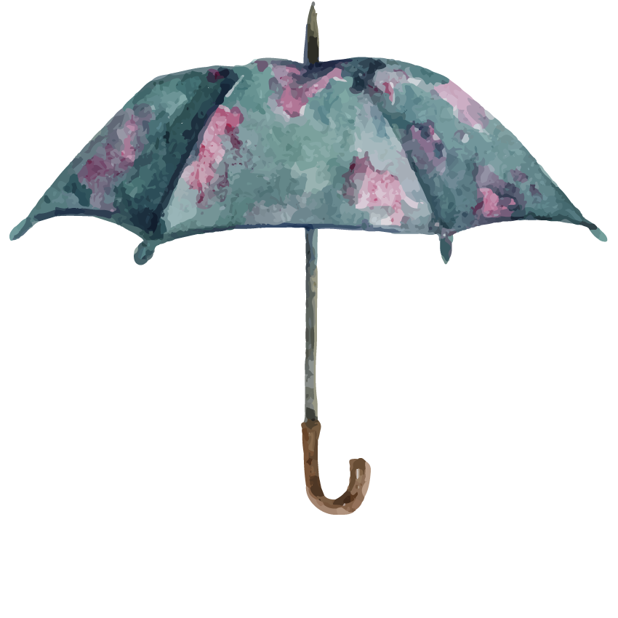
Sexual Violence
Notes:
Sexual Violence as a broad definition (an umbrella term) – a range of “sexually violent behaviors” exist along the continuum. Those behaviors fall into touch/non-touch and are all considered sexual violence.
Sexual Violence is NOT just rape. Sexual violence is any sexual activity without consent.

Slide 4

Sexual Violence
NON-TOUCH
TOUCH
Voyeurism/ peeping
Forcing someone to watch or participate in pornography
Verbal comments
Exposing genitals
Taking sexualized photographs
Dissemination of intimate images (revenge porn)
Images of child sexual abuse (child pornography)
Touch/grab body parts
Intercourse with penetration (oral/anal/vaginal)
Penetration with objects
Survival sex
Institutional & statutory sexual assault
Sexual Exploitation and Trafficking
Notes:
Sexual violence exists along a continuum.
PAAR provides services to people who have had experiences along this continuum, not just the traditional definition of “rape.” All of the things on this spectrum exist under the umbrella of SV. It is important to have this broad definition and understanding, not to leave anyone out of the conversation on sexual violence.
Fake hierarchy of trauma – We can’t compare an individual’s trauma to someone else’s (Society tries to make us think there is a hierarchy of what is more “serious” and our laws reflect that belief, but it’s important to recognize trauma as more individualized).
E.g. A survivor might think “My trauma doesn’t matter as much” because it doesn’t appear as “serious” on that hierarchy. Someone's emotional response to trauma is rooted in their experience as an individual – it can’t be predicted based on that fake hierarchy.

Slide 5

Understanding the Landscape
60% of black girls will experience childhood sexual abuse.
People with a disability are twice as likely to experience sexual violence.
2
1
People are more likely to blame the victim if they are black or Latinx.
1 in 4 girls and 1 in 6 boys are sexually abused by age 18.
5
3
People who identify as transgender are significantly less likely to seek help from service providers.
1 in 6 women and 1 in 33 men have experienced sexual violence.
4
2
All reference information (1-6) available on “resources” slide.
Notes:
You might be familiar with the “1 in 4” and “1 in 6” statistic about the prevalence of child sexual abuse. We tend to talk about statistics as male/female, but there are many other factors that come into play with sexual violence beyond the binary genders. It's important to have a broader view than just male/female.. For instance, we know that people who identify as Transgender are twice as likely to experience sexual violence. And, less likely to seek help from a service provider.
SV happens in all communities – no one is immune, but there is a lot of research showing in epidemic in some communities. For example, national data indicates that 1 in 6 women have been victims of sexual assault – among black women, it’s 1 in 5. And that number rises to 1 in 3 for women who identify as multi-racial (National Intimate Partner and Sexual Violence Survey).
(Scholars have written extensively about America’s history of objectifying African American women, and how it contributes to higher rates of sexual assault among women of color).
Smith, N., Harrell, S. Sexual Abuse of Children with Disabilities: A National Snapshot. March 2013. VERA Institute.
YWCA Gender-based violence fact sheet
RAINN
National Institute of Justice report
Lewis et. Al 2018 – cultureofrespect.org

Slide 6
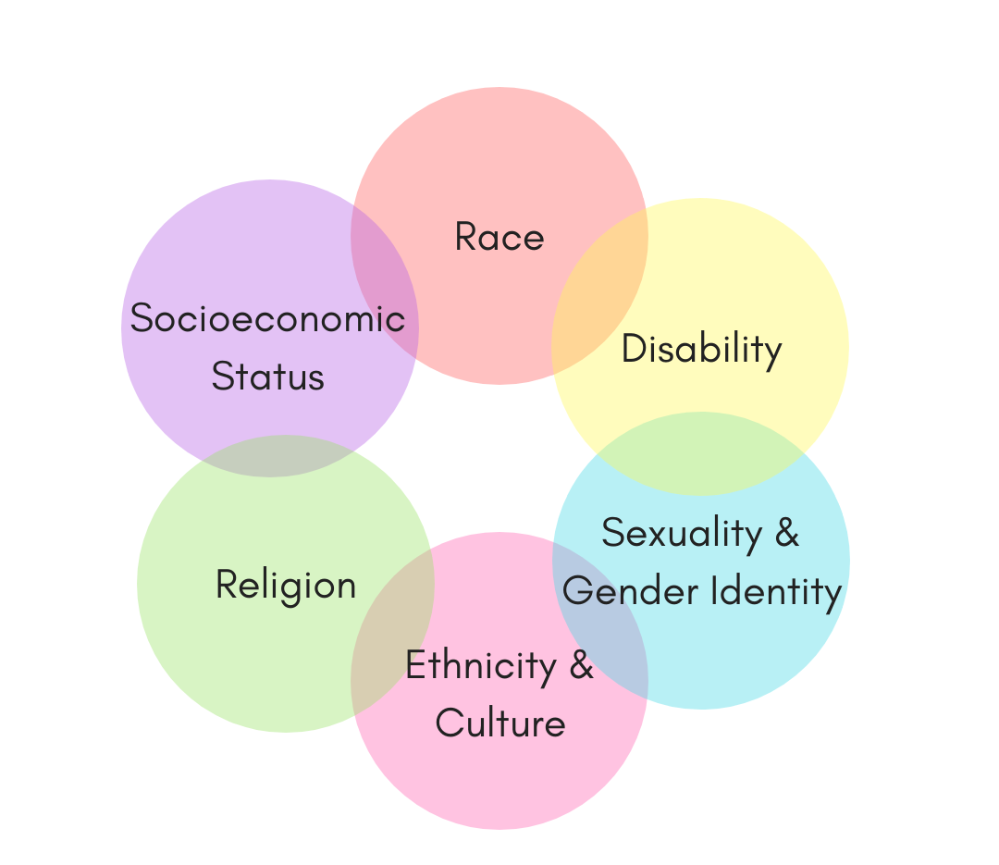
Intersectionality
The interconnected nature of social categorizations such as race, class, and gender, regarded as creating overlapping and interdependent systems of discrimination or disadvantage; a theoretical approach based on such a premise.
(Oxford Dictionary)
Notes:
Intersectionality is – ….
Each of those risk factors and marginalized communities don’t exist in isolation. We know that women are more at risk for SV. But if a woman identifies as LGBTQ+ or is a woman of color, those risk factors stack on top of each other to create increased vulnerability. It becomes, then, important that we look at people as their whole being, and not just one piece of their identities.
Someone’s interlocking identities will impact their likelihood of experiencing sexual violence – but it also impacts their experience in disclosing and seeking help. It impacts their experience navigating systems and institutions as a survivor. What does it look like to be a person of color, or a Trans individual, and have to trust the police, the health care system, and mental health providers? Would that survivor face bias in those systems, what is the likelihood that they would experience racism or homophobia?
For college students specifically, university response is built around cisgender, heteronormative, white experiences. This can result in traumatic misgendering, attitudes that the dynamics of SA in the LBGTQ+ community is "too confusing/messy," increased rates of victim blaming due to racist/homophobic beliefs, and a fear that their experiences will reflect/confirm stereotypes (Coulter & Rankin, 2017).
Racial and gender identities compound a survivor’s experience in systems and institutions – ones that are often rooted in oppression and come with implicit bias, racism and homophobia.
Those systems are meant to provide aid to survivors, but become re-victimizing or re-traumatizing to the survivors navigating them. As part of an institution (conduct board) (police), you have the potential to re-traumatize survivors, and that’s what we want to avoid in thinking about your role and response to sexual violence on campus.
E.g. Gender Equity Report released by the city of Pgh shows disproportionate maternal mortality rate among black women.. Not because they aren’t seeking care, but because they aren’t being heard by medical providers.

Slide 7
Sexual Violence and Men
COMMON REACTIONS AMONG MALE-IDENTIFIED SURVIVORS
    Shame and self-doubt, believing men should be “strong enough” to stop an assault
    Confusion about normal physiological responses during the incident
    Concerns or questions about sexual orientation
    Feeling like “less of a man” or that you no longer have control over your own body
    Withdrawal from relationships or friendships and an increased sense of isolation
    Worry about disclosing and the fear of judgement or disbelief
Notes:
We saw in the prevalence statistics a few minutes ago that 1 in 6 boys will experience sexual abuse by the time they are 18 years old. As students come to your campus, they bring those prior experiences along. We tend to think about instances of assault or abuse that take place while people are students, but it is just as important to consider what our students are brining with them as they come to campus.
While SV disproportionally impacts women, we also know that the statistics on male victims are much lower than the actual instances of violence. Male victimization remains vastly underreported, and there are unique barriers for men and boys in disclosing SA and seeking help.
Research suggests that it takes an average of 3 decades for men to report abuse. Common to see disclosure spike when high-profile cases are in the media, this helps to validate that they are not to blame and they are not abnormal.
(www.theguardian.com/commentisfree/2020/jan/16/male-rape-victims-sexual-abuse-support )
At PAAR, we serve male victims. But, we tend to see boys <age 12 and adult men >age 40. We have very low service rates with teens and young men.
We can help reduce this by using neutral language when we talk about sexual violence, and being intentional not to reinforce stereotypes about what it means to be “masculine.”
Boxing people into gender roles is unhelpful – it can prevent survivors from disclosing and seeking help. E.g. “thinking boys will boys” is really not productive.

Slide 8

Sexual Violence on Campus
    Estimates are 1 in 5 women and 1 in 16 men are sexually assaulted while in college.
    College students are most at risk in the first 6 weeks of their college experience.
    73% of LGBTQ+ students experience sexual assault or harassment and 6% of those students change schools.
    Students with disabilities experience sexual violence on campus at 3x the rate than students without disabilities.
    90% of sexual assaults are committed by a friend or acquaintance.
    AND
    50% of cases involve alcohol consumption by the victim, perpetrator, or both.
RAINN
Notes:
Common themes in on-campus sexual assault:
84% of female survivors report being sexually assaulted during their first four semesters on campus. This is sometimes referred to as the “Red Zone,” which we will look at more in-depth in a minute.
90% of campus sexual assaults are committed by perpetrators that the survivor knows.
Involve alcohol consumption
Source: Know Your IX and RAINN
US Department of Justice – The Campus Sexual Assault Study (2007)
Bureau of Justice Statistics (2000) – The Sexual Victimization of College Women
American Addiction Centers (2020)- Sexual Assaults on College Campuses Involving Alcohol
US Department of Justice – The Campus Sexual Assault Study (2007)
National Online Resource Center on Violence Against Women (2009) - Culturally Competent Service Provision to Lesbian, Gay, Bisexual and Transgender Survivors of Sexual Violence
Bureau of Justice Statistics (2014) – Crime Against Persons with Disabilities

Slide 9
Sexual Violence on Campus
The "Red Zone"
A time of statistically higher instances of sexual assault: spanning the start of the fall semester through Thanksgiving break when 50% of college sexual assaults occur.
84% of survivors reporting being sexually assaulted during their first four semester on campus
College students are most at risk in the first 6 weeks to 10 of their college experience
#ReclaimRedZones at End Rape On Campus (EROC)
Notes:
Coincides with countless new academic year parties/returning to campus
“Rush" events
Freshmen particularly vulnerable: testing independence and freedoms, lacking social networks and supports, lack of intervention skills
1.5.11_The-Red-Zone-Sexual-Violence-on-College-Campuses_INFOSHEET_V2.pdf (metoomvmt.org)
Statistics - Know Your IX
Experts say new methods needed to combat the Red Zone on campuses (insidehighered.com)
Reclaim Red Zones — END RAPE ON CAMPUS

Slide 10


Reporting Sexual Violence
“Sexual violence is one of the most UNDER-REPORTED CRIMES with 68% of assaults left unreported.”
For sexual assaults that take place on college campuses, 93% remain unreported.
U.S. Department of Justice – National Crime Victimization Survey (2008-2012).
White House Not Alone Report (2017).
Notes:
This statistic helps us to keep perspective that in disclosure, we are only seeing the tip of the iceberg of all the sexual violence that is really happening (Justice Department, National Crime Victimization Survey: 2008-2012).
Even with the MeToo movement and more visibility in the media, there is incredible stigma that exists that keeps victims from coming forward and disclosing their experiences. It is so important that we are prepared to respond to the victims who do disclose, because we know that is not the norm.
College-specific data: White House “Not Alone” Report (2017):
(2017): Report cited lack of reporting among survivors, with just 7% of disclosed sexual assaults reported to school authorities or campus police (or, 93% unreported). Underscore that college students are reporting at rates significantly less than general public.
Under-reporting (national data, not college-specific) and the lens of intersectionality:
For every (1) case reported to the police by a black woman, 15 more remain unreported. Despite seeing high rates of SV among black girls and women, we see incredible disproportionality in how those crimes are reported (Bureau of Justice Statistics).
Among school-aged girls, immigrant girls are almost twice as likely as their non-immigrant peers to have experienced recurring incidents of sexual assault. Mistrust of systems and fear of being out-of-status are common barriers reported by survivors.
(Know Your Nine 2007).

Slide 11
Barriers in Disclosure
College students cite a number of reasons for not reporting –
    Not wanting others to know
    Lack of proof
    Fear of retaliation
    Being unsure of whether what happened constitutes assault
    Not knowing how to report
    Fear of being treated poorly by the criminal justice system
Common barriers (non-age specific) –
    Shame and guilt
    Fear of not being believed
    Lack of support
    Relationship to perpetrator
    Unaware of options/resources
Notes:
College-specific data: White House “Not Alone” Report (2017):
Survivors cite a number of reasons for not reporting:
Not wanting others to know
Lack of proof
Fear of retaliation
Being unsure of whether what happened constitutes assault
Did not know how to report
Fear of being treated poorly by the criminal justice system
Common barriers (non-college specific) –
Perceived lack of options – not knowing how to report
Fear of being blamed
Fear of not being believed
Self-blame or guilt​
Shame or embarrassment​
Fear of perceptions​ or being judged
Fear of not being believed ​
Lack of trust in the criminal justice system​
Lack of support from friends and family​
Unaware of options/resources
Don’t view the experience as a victimization
Unsafe to disclose/report
Relationship to perpetrator
Write notes about barriers in disclosure and reporting –
Despite the “common themes,” there is a misperception about what campus SA looks like. Fear of judgement or being blamed keeps survivors from disclosing (e.g. involved alcohol, fear of retaliation or isolation from peer group, guilt and self-blame about what caused the SA, consent issues, didn’t tell right away, mistrust of institution or perceived lack of options, doesn’t identify incident as assault or abuse).
E.g. Alcohol impacts shame, perception of barriers, fear of being judged, memory and perception of credibility in disclosing
Some students are at a higher risk of victimization on campus, or experience negative repercussions when they do report, so these common themes impact the likelihood of disclosure even more for marginalized students (LGBTQ+, people of color, etc).

Slide 12

“Perfect victim” is the model against which all other (normal, flawed, human) victims are judged.
“The perfect victim says no clearly and often, fights off her attacker like a honey badger, and if she can’t get away, she continues to profess her non-consent throughout the encounter, ideally by shouting “no” and continuing to fight as best she can.”
The Sydney Morning Herald- Schetzer, Alana: "The 'Perfect Victim" of Sexual Assault is a Muth That Needs To Go" (April 2017)
Notes:
The "perfect victim" myth places disproportionate emphasis on the victim's demographics, circumstances, and reactions:
Young, innocent, single female (“she”)
White
No criminal background or history of mental health
Not intoxicated or addicted
Does not know offender
Not wearing provocative clothing
Not sexually active
Never reported rape before
Tried to fight off or run from offender
Victim to forcible rape; nothing less than physical violence with visible injuries
Reported to police immediate WITH evidence
Offender used extreme violence and/or weapon
Offender is male
Situation was unfamiliar
Presents as depressed, distressed, and/or ill adjusted
Ends all contact with abuser.
Hysterical crying, distraught, fearful during disclosure
Expectations of victims based on depictions in media and stories we see on the news. All victims are held up to the standards these stories have created, placing the blame and responsibility on the vicitm. Any variation or deviation from this narrative is a hang up for systems, often where they fall short and instill harm.
DCRCC: Powering a Culture of Consent (2020)- Myths About Sexual Violence

Slide 13
"The myth of the perfect victim is just the opposite side of the monster myth coin.
For years, women have been taught to be careful walking alone at night, looking out for the bogeyman who's going to jump out of the dark and grab them and drag them away. Yet most sexual crimes are committed by people known by the victim, and often in their own homes."
The Sydney Morning Herald- Schetzer, Alana: "The 'Perfect Victim" of Sexual Assault is a Muth That Needs To Go" (April 2017)
Notes:
The same news stories and media instills the "monster" myth—instilling the idea that ONLY monsters commit sexual violence, in very monsterous ways:
Male and stranger to the victim
An archetypcal villain: "pure evil", psychotic or sociopathic
Actions are excessively violent
Crime occurs in "dangerous areas" and not everyday locations
A well documented history of violence or mental illness
Lives outside of social norms: lacking career, homes, family or friends
This myth trivializes any sexual violence that occures outside of these expectations, disperportionately focusing on the rarest of rapes and hids the real complexity of sexual violence. People we know, love, and respect in our society and communities can commit violence, too.
ABC News (2014)- The Danger of the Monster Myth, Tom Meagher

Slide 14
Shame and Secrecy
“The intensely painful feeling or experience of believing that we are flawed and therefore unworthy of love and belonging – something we’ve experienced, done, or failed to do makes us unworthy of connection.” (Dr. Brene Brown)
    Shame and secrecy are central to sexual trauma
    Victims might feel responsible for the abuse, and feel shame as a result: “I was assaulted because I am (…)”
Rita Abadi, LMHC – Mt. Sinai Hospital (2017)
Notes:
Shame and secrecy could make an individual not view their experience as a victimization – because they blame themselves. Or, they could be reluctant to disclose and ask for help because they don’t want to be judged.
*Clinical concept of the “Just world belief.”
We have all learned that bad things happen to bad people. We know that that’s not true, but it is easier for our brain to accept that, than the random nature of bad things happening. So, when someone experiences a SA our brain kind of sabotages us and says that it’s because there is something wrong with us, or we must have done something wrong.. I was assaulted because ___
Feeling unsafe because violence can happen to anyone v. adapting your world view to believe you are “bad”

Slide 15
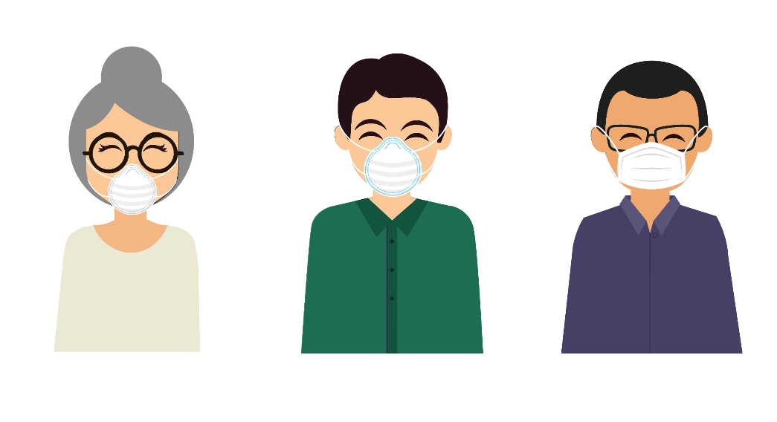

Research Shows
“The FIRST RESPONSE to victims is critical in determining how victims cope.”
U.S. Department of Justice, the Office of Victims of Crime
Notes:
Research indicates that survivors who have prompt, supportive responses benefit in two ways:
More likely to heal and recover
More likely to seek services and engage with systems
This reinforces the importance of our response to survivors – as providers or as staff/faculty, it is critical that we can hold space to listen to survivors, that we normalize and validate their experiences, and that we know what information and options to present.

Slide 16
trauma THEORY

Slide 17
Understanding Trauma
DSM-5 AND TRAUMA
    The person experienced, witnessed or was confronted with an event(s) that involved actual or threatened death or serious injury, or a threat to the physical integrity of self or others.
    The person’s response involved intense fear, helplessness or horror.
  Diagnostic and Statistical Manual of Mental Disorders (DSM-5) – 309.81 PTSD (2013)
Notes:
Trauma is a unique experience for everyone… no (2) traumas look the same.
We talk about trauma in the context of SV but reading that definition, you could apply this information it to many experiences that people have throughout their lifetime, as there are commonalities with sexual-based trauma.
Two people might have similar dynamics in their sexual assault, but different reactions. One might have those classic trauma symptoms and the other not.. It’s important to look at how that (1) individual is reacting, and not assume that it will be the same for everyone.

Slide 18
Understanding Trauma
    One single, overwhelming event. ACUTE TRAUMA
    Extended exposure to trauma and experiences that are linked to development and/or relationships. COMPLEX TRAUMA
    “The experience of multiple, chronic and prolonged, developmentally adverse traumatic events, most often of an interpersonal nature.. and an early life onset.” (Besel van der Kolk, 2005)
Bessel van der Kolk, M.D. – The Body Keeps the Score (2014).
Notes:
WHAT MAKES AN EXPERIENCE TRAUMATIC
The experience involves a threat to one’s physical or emotional well-being.
It is overwhelming.
It results in intense feelings of fear and lack of control.
It leaves people feeling helpless.
It changes the way a person understands themselves, the world and others.

Slide 19
Understanding Trauma
TRAUMA COULD LOOK LIKE –
    Inability to regulate emotions (anger and aggression)
    Emotional numbing
    Feeling isolated or unable to form connections
    Unhealthy coping skills
    “Survival mode” and automated brain response –
      Fight / Flight/ Freeze / Fawn
      Lack of language to attach to the experience
      Memory gaps and/or non-linear progression
Notes:
When someone experiences a trauma, the brain is not fully able to process the event and responds by numbing or shutting down our normal emotional response.
It’s important to know what that looks like, because someone most likely won’t be saying, “I have experienced complex trauma and need help managing symptoms.”
Trauma can cause unusually strong emotional responses, and overwhelm our normal coping mechanisms. This looks like:
Inability to regulate emotions: Big, emotions are common, as well as misplaced anger.
Emotional numbing: Or having a flat affect… Feeling disconnected from their emotions.
Withdrawing from social activities, relationships and connections
People find ways to cope – sometimes we view coping skills as “unhealthy” but people will do what works when they need to numb their feelings or avoid intrusive thoughts.
Recounting the incident becomes very difficult, because the way our brain processes information and stores memories is altered by trauma.. This means survivors might be unable to make meaning of what happened to them, lack the language to articulate or describe it, and have “gaps” or missing pieces of their memory, including accounts of the incident are non-linear.

Slide 20

The Brain & Trauma
TRAUMA OVERWHELMS OUR ABILITLY TO
    Have a sense of control
    Make meaning of our experience
    Maintain connection to others
RESEARCH SHOWS THAT OUR BRAIN FUNCTIONS DIFFERENTLY WHEN WE EXPERIENCE TRAUMA.
Judith Herman, M.D. – Trauma and Recovery (1997).
Notes:
Research shows that our brain functions differently when we experience trauma – Reframe how someone reacted in the moment as an automatic response from the brain.. this is critical because it helps providers view a survivor’s behavior as common, or the “norm” and this is also healing for survivors, because we are removing some of the blame or judgment about their reactions in the moment.
The “neurobiology of trauma,” or how our brain functions during and following a traumatic incident, is the “why” in:
How someone responds in the moment
How someone recounts or recalls the traumatic incident
Reactions, behavior and symptoms that come up following the incident
Judith Herman – pioneer in trauma theory

Slide 21
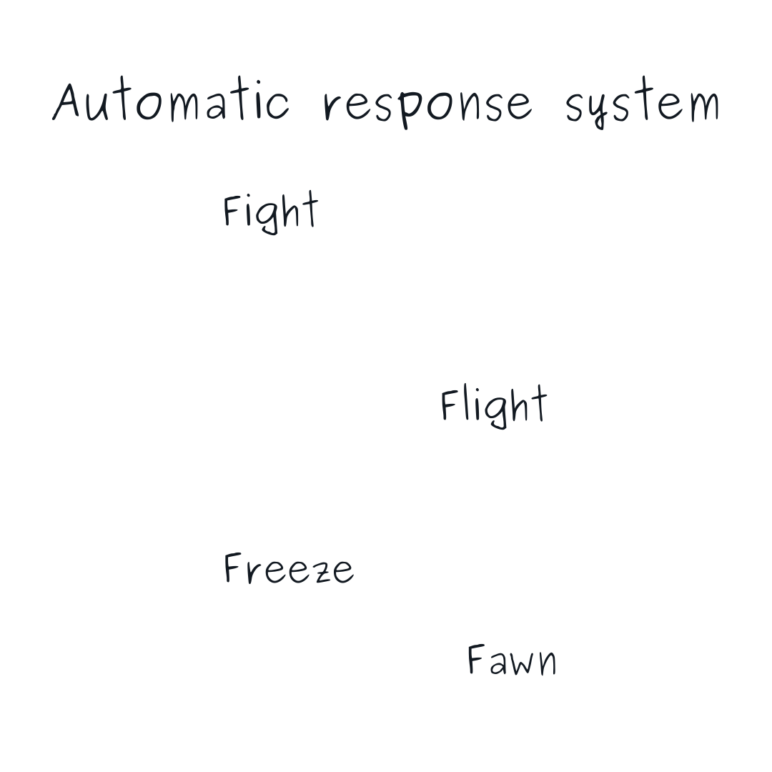




The Brain & Trauma
Notes:
Our brain functions differently when we experience a trauma. One of the response systems that helps us cope with trauma is our stress response modes (think Thalamus & its release of hormones, playing large role in which response is chosen), which allow us to quickly respond to threats and get to safety:
1) To FIGHT is to confront the threat aggressively.
2) FLIGHT means running or fleeing the situation.
3) FREEZE is becoming unable to move or act against the threat.
4) FAWN is the response of complying with the attacker to save self and avoid an esclation of violence; “people-pleasing” or “appeasing”
**(common response among people with a history in complex trauma, where fight/flight was not an option, ex: childhood trauma developing into adulthood complex trauma).
EXAMPLE: IPV abuser may suppress a victim’s fight or flight response by threatening punishment, bad outcomes, self-harm, etc., leading to the victim’s reliance on the fawn or freeze response. “Occurs when survivors read danger signals and aim to comply/minimize the confrontation in an attempt to protect themselves.”
EXAMPLE: Victims who provide their rapists a form of protection, not as an act of consent, but out of an attempt to fawn and mitigate additional negative outcomes (e.g. condom to prevent STD, unplanned pregnancy, etc.)
The body responds in automatic ways – these are all normal reactions (survival mode) to abnormal events (trauma theory, loss of control). No one response is better or worse than another; in fact, we have zero control over which one our brains will choose. They will choose which every they perceive will most likely help us survive.
Korbel, M. (2018). Sometimes you make your rapist breakfast.
Gaba, S. (2020). Understanding fight, flight, freeze, and the fawn response: another possible response to trauma.

Slide 22
TRAUMA RESPONSES
FIGHT Crying Hands and jaw clenched, grinding teeth Fight in eyes, glaring, fight in voice Desire to stomp, kick, punch Feelings of anger/rage Homicidal/suicidal feelings Knotted stomach/nausea, burning stomach | FLIGHT Restless legs/feet Numbness in extremities Anxiety/shallow breathing Big/daring eyes Leg/foot movement Feeling fidgety, trapped, tense or restless Sense of running for life, activity focused
FREEZE Feeling stuck in some part of body Feeling frozen/numb/cold Sense of stiffness, heaviness Holding breath/restricted breathing Sense of dread, heart pounding Decreased heart rate Feeling of tolerating the stress | FAWN People pleasing Complying with other's wishes or demands Caring for others over your own detriment Unable to say how you really think or feel Flattering others Avoiding conflict Feelings of being taken advantage of Overly concerned with others
Notes:
Source: Fight, Flight, Freeze: How to recognize it and what to do when it happens (BetterHelp):
https://www.betterhelp.com/advice/trauma/fight-flight-freeze-how-to-recognize-it-and-what-to-do-when-it-happens/

Slide 23
COMMON RESPONSES AND EXPERIENCES
Notes:
It’s important to know what’s happening in the brain, but you won’t be able to see that in the people you work with. Now we want to focus a little bit on the way trauma presents in the people you work with.

Slide 24
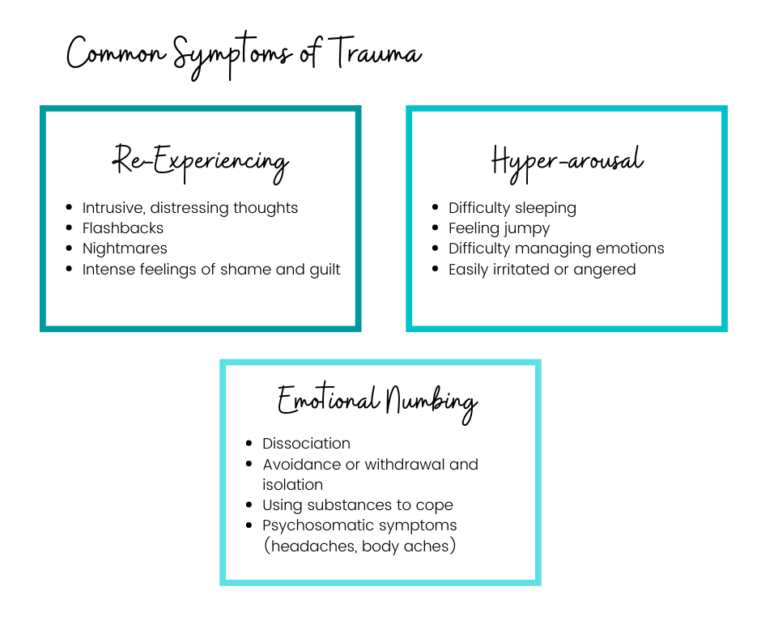

Notes:
This is how the DSM classifies symptoms of trauma…
Each survivor is unique, but each person will have a “main” area where their symptoms fall. It might change in time, but it is important to note where someone tends to cluster for observation reasons.
Images are saved in Sadie’s Canva.

Slide 25
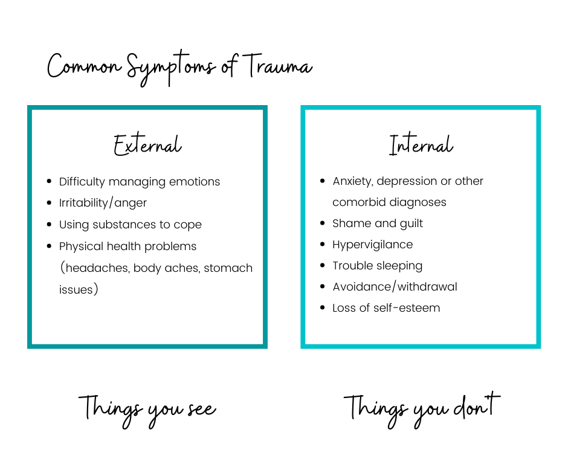
Notes:
It’s also important to note the difference between externalized vs internalized symptoms:
Externalized symptoms are the things you will SEE, like anger or irritation, coping with substances, when someone jumps because of an escalated startle response…
Internalized you are more likely to HEAR directly from the person or to notice red flags, like feelings of guilt and shame or anxiety and depression.

Slide 26
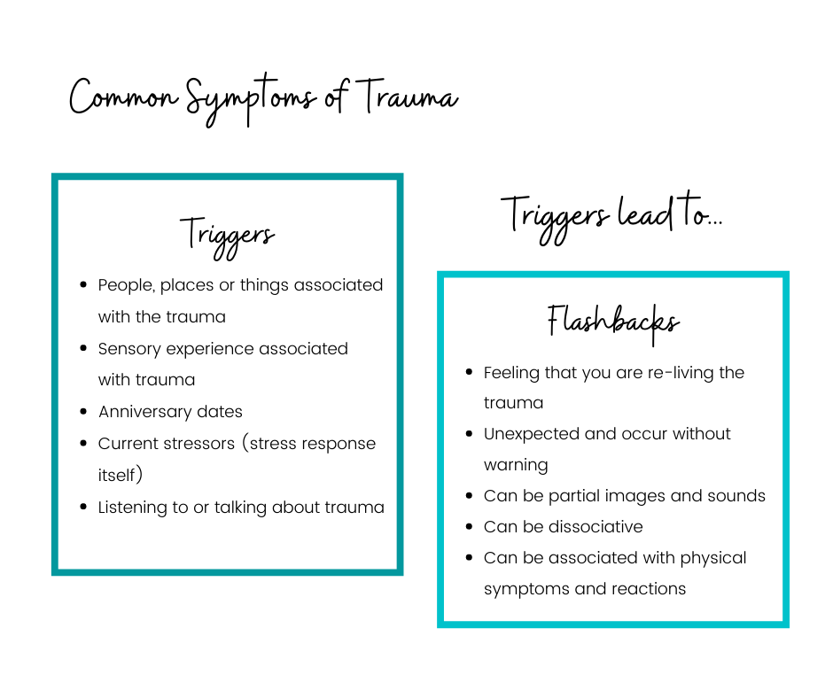
Notes:
WHY: Reference neurobiology. When the amygdala sent out the “danger signal,” the sensory data stopped there. Meaning the information did not make its way to the prefrontal cortex or become process in the same way as non-dangerous information. When survivors experience a trigger, their brain functioning is impaired just like at the time of the trauma. It becomes difficult to make decisions in the moment, to regulate or manage emotions, and the lack of a date/time stamp on the memory means the brain is unable to distinguish that the trauma is not reoccurring in real time.
e.g. Popcorn.
Triggers are one of the most common symptoms, making it critical that we can normalize for survivors that triggers are real (and common)
e.g. Survivors who feel like “I am crazy” because they don’t recognize how they are reacting to the trauma.
Help survivors develop a toolbox of coping skills. Encourage them to practice those coping skills when they are not actively in crisis – this helps make the skills more routine and accessible when they are needed.
Dissociation: When people dissociate, they disconnect from their surroundings… this stops the trauma memories and lowers fear, anxiety, and shame. Dissociation can happen during the trauma, or later in time when the survivor is triggered or reminded of the trauma (it services as a coping mechanism). Dissociation is a common symptom of PTSD.
NOTE
Virtual training will be offered on how to respond to disclosure.

Slide 27
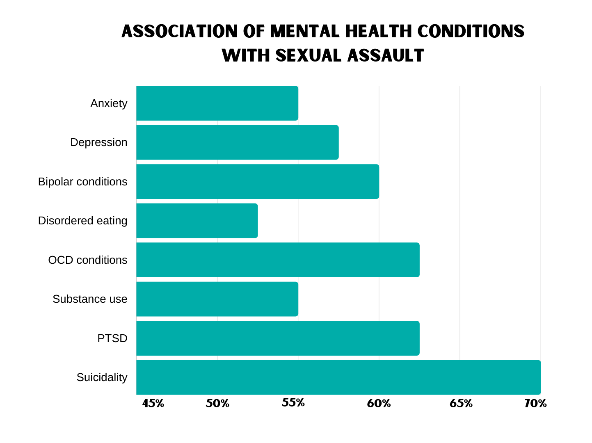
NIH – Dworkin, Menon, Bystrynski and Allen: "Sexual Assault victimization and psychopathology: A review and meta-analysis“ (2017).
Notes:
Source: NIH (2017) Dworkin, Menon, Bystrynski and Allen: "Sexual assault victimization and psychopathology: A review and meta-analysis.”
Meta-analysis of data collected in various research studies from 1970-2014. In total, the studies contained 238,623 individuals who had reported to a sexual assault center within 74 hours of the assault.
It is important to normalize for survivors how common trauma symptoms are – there is a real and widespread impact on our bodies and our brains. Note that this chart starts at 45%, meaning at least 45% of survivors experienced symptoms.
Trauma manifests as symptoms we tend to associate with mental health conditions. Misdiagnosis happens because trauma presents as those disorders.
These things are important to know for observation – that we expect to see in survivors and can normalize. From a treatment perspective, it is important to make the link between these conditions back to the trauma and not overlook the underlying or root cause of the symptoms.

Slide 28
Notes:
Questions?

Slide 29
DEVELOPING A RESPONSE

Slide 30
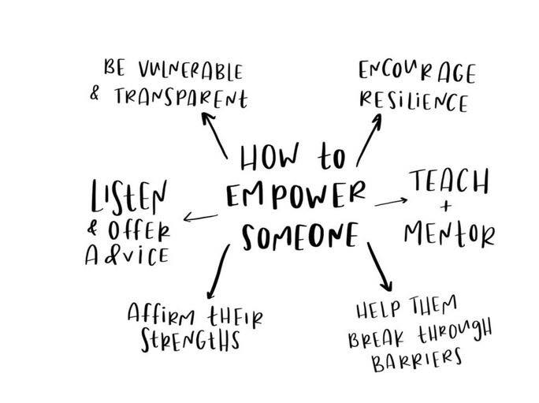
Responding to College Students
    EMPOWERMENT AND STRENGTHS – BASED APPROACH
    Understand and communicate the limits of your confidentiality
    Utilize active listening skills
    Provide choice and control, however small
    Look for opportunities to acknowledge their resilience/ strengths
Notes:
Shame and secrecy make victims/survivors hyper-aware of judgement. Be mindful of the language you choose (neutral) and don’t make statements or ask questions that might indicate you are blaming or judging them.
e.g. Seeking medical care in the hospital.
Add more campus-specific examples – e.g. faculty in class v RA

Slide 31

Mitigating Trauma
PROMOTE SAFETY –
    Create areas that are calm and comfortable
    Acknowledge the difficulty of talking about the incident
    Preface sensitive questions with why the question is being asked
PROVIDE CHOICE –
    Provide choices and control – spectrum of participation
    Explain purpose and what will happen next
Notes:
Trauma impairs memory & concentration – it also impacts an individual’s ability to trust, cope, and form healthy relationships.
Vctms frequently feel a lack of control when interacting with systems like the police/criminal justice process. They might feel unheard, have difficulty trusting, and may be unwilling to cooperate/collaborate. What helps?

Slide 32
Mitigating Trauma
COLLABORATION AND TRUST –
    Check in with yourself: are they informed and involved
    Provide clear, consistent information
    Be mindful of language and implications
EMPOWER –
    Look to their capabilities and strengths
    Promote access to resources and opportunities to heal
Notes:
Trauma impairs memory & concentration – it also impacts an individual’s ability to trust, cope, and form healthy relationships.
Victims frequently feel a lack of control when interacting with systems like the police/criminal justice process. They might feel unheard, have difficulty trusting, and may be unwilling to cooperate/collaborate. What helps?

Slide 33
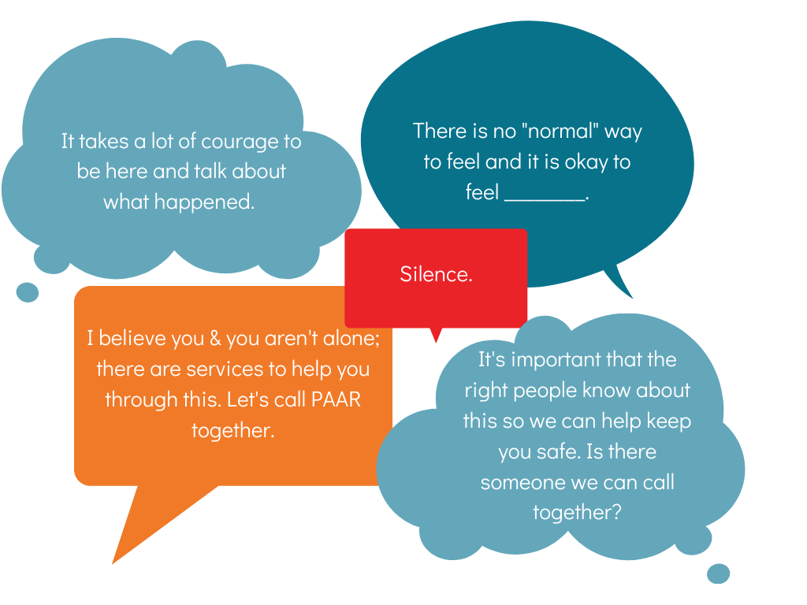
BELIEVE AND EMPOWER
Notes:
How you say something is often more impactful than having the perfect words. When we can be genuine, and just ourselves, it conveys an important message to the survivor. Take one of these statements and practice it on your own, until it sounds and feels like something that is natural to you. Having a “go to” statement that is automatic will give you a minute to process and ground yourself in the moment before you start forming a response.

Slide 34
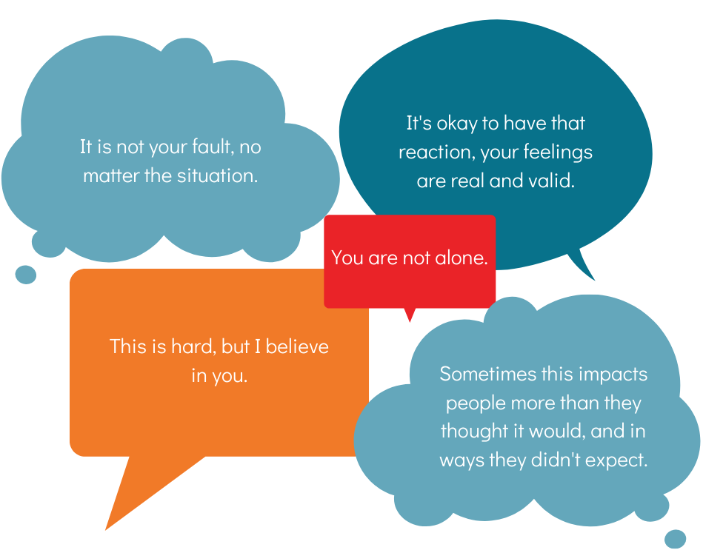
NORMALIZE AND VALIDATE

Slide 35



PAAR Services
The Helpline
    Confidential information and support, available in (3) ways:
    Call the Helpline, 24/7
  1-866-END-RAPE
CHAT PORTAL*
Live chat with a Helpline worker by clicking the Chat Portal on the PAAR website (www.paar.net):
TEXT MESSAGE*
Information and support, available by sending a text message to the PAAR Helpline.
Notes:
*Open at various times based on PAAR availability
How to make a referral to PAAR

Slide 36
PAAR Services
VICTIM RESPONSE TEAM
    MEDICAL ADVOCACY
    LEGAL ADVOCACY AND ACCOMPANIMENT
    CRISIS COUNSELING IN VARIOUS SETTINGS
CLINICAL SERVICES
PAAR provides individual and group trauma therapy at no cost. PAAR’s comprehensive evidence-based treatment approaches can help survivors manage their emotions and begin the healing process:
    INDIVIDUAL TRAUMA THERAPY
    GROUPS
    CHILD AND FAMILY COUNSELING CENTER
  1-866-END-RAPE

Slide 37
CITED MATERIAL Resources
Intersectionality statistics:
VERA Institute – Nancy Smith and Sandra Harrell, Sexual abuse of children with disabilities: A national snapshot (March 2013).
YWCA: Gender-based Violence Fact Sheet
Stotzer, R. (2009)
National Sexual Violence Resource Center (NSVRC)
UNICEF – Sexual and gender-based violence against refugees, returnees and internally displaced persons (May 2003).
CALCASA
Sexual Violence on Campus statistics:
1
2
3
4
5
6

Slide 38
CITED MATERIAL Resources
Tea and Consent Video: https://www.youtube.com/watch?v=fGoWLWS4-kU
The Guardian: Male rape survivors suffer in silence. We need to help them talk (2020).
Judith Herman, M.D. – Trauma and Recovery: The aftermath of violence, from domestic abuse to political terror (2015).
Jim Hopper, Ph.D. – Sexual Assault and the Brain (2019).
NIH – Dworkin, Menon, Bystrynski and Allen: "Sexual Assault victimization and psychopathology: A review and meta-analysis“ (2017).
Brene Brown on Empathy: https://www.youtube.com/watch?v=1Evwgu369Jw&feature=youtu.be

Slide 39
Resources
Additional reading:
The Body Keeps the Score (Bessel Van der Kolk)
The Deepest Well: Healing the Long-Term Effects of Childhood Adversity (Dr. Nadine Burke Harris)
Marissa Korbel in Harpers Bazaar: Sometimes you make your rapist breakfast (2018). https://www.harpersbazaar.com/culture/features/a19158567/what-is-rape/
Juliette Virzi in The Mighty: Fawning: The fourth trauma response we don’t talk about (2020). https://themighty.com/2020/01/fight-flight-freeze-fawn-trauma-responses/
Sammy Caiola in CapRadio: Sexual Assault Survivors Want Less Police, More Trauma-Informed Professionals – Especially for Black Victims (2020). https://www.capradio.org/articles/2020/07/28/sexual-assault-survivors-want-less-police-more-trauma-informed-professionals-especially-for-black-victims/

Slide 40
81 S. 19th St.
Pittsburgh, PA 15203
P: (412) 431-5665
1-866-END-RAPE paar.net
Notes:
Wrap Up:
Thank participants (and ask them to complete the evaluation).

